Slide 1
Programming 6
Workshop on CMake
johan.korten@han.nl
V1.0 Nov 2025

Slide 2
Workshop Topics overview
Clean code (beyond SOLID)
CMake
Unit testing
Commentaar
Patterns (Clean architecture)

Slide 3
Workshop Topics for Today
Build Nightmare
- Overcoming the Build Nightmare
- Cmake ins- and outs
- Cmake for Embedded targets
- Alternative to Make

Slide 4
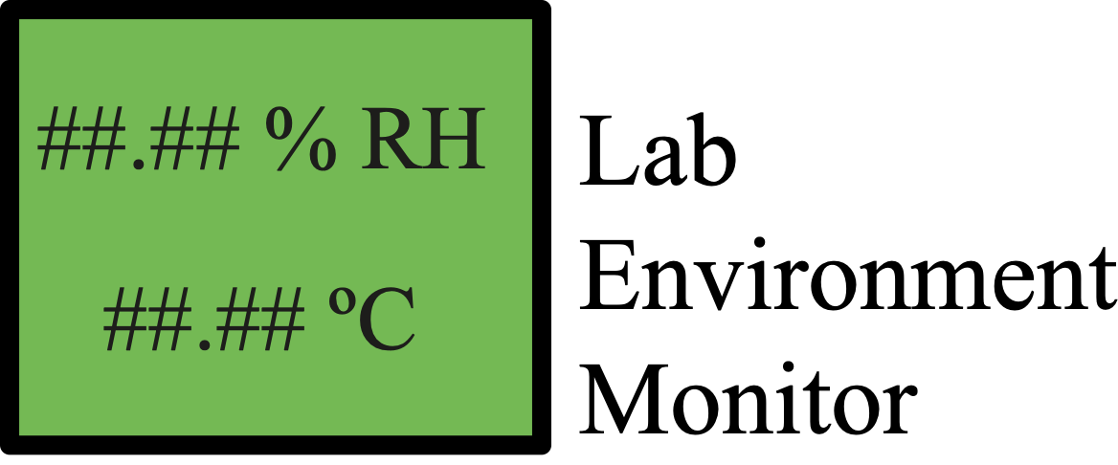
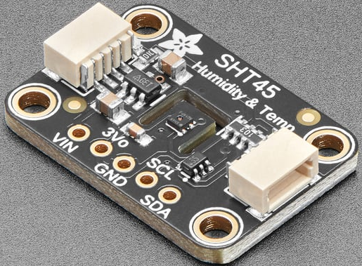
Example project for today
Build Nightmare
SHT45
- Temperature
- Humidity Sensor

Slide 5
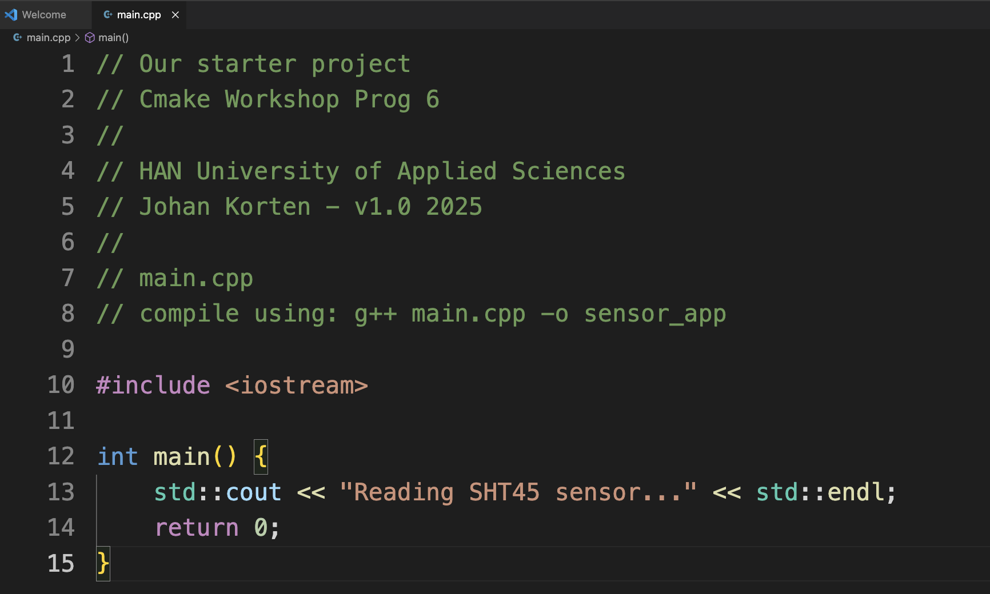
Pragmatic start - Stepping stone 1
Build Nightmare
SimpleProject

Slide 6
Pragmatic start - Stepping stone 1
Build Nightmare
Compile and test:
SimpleProject

Slide 7
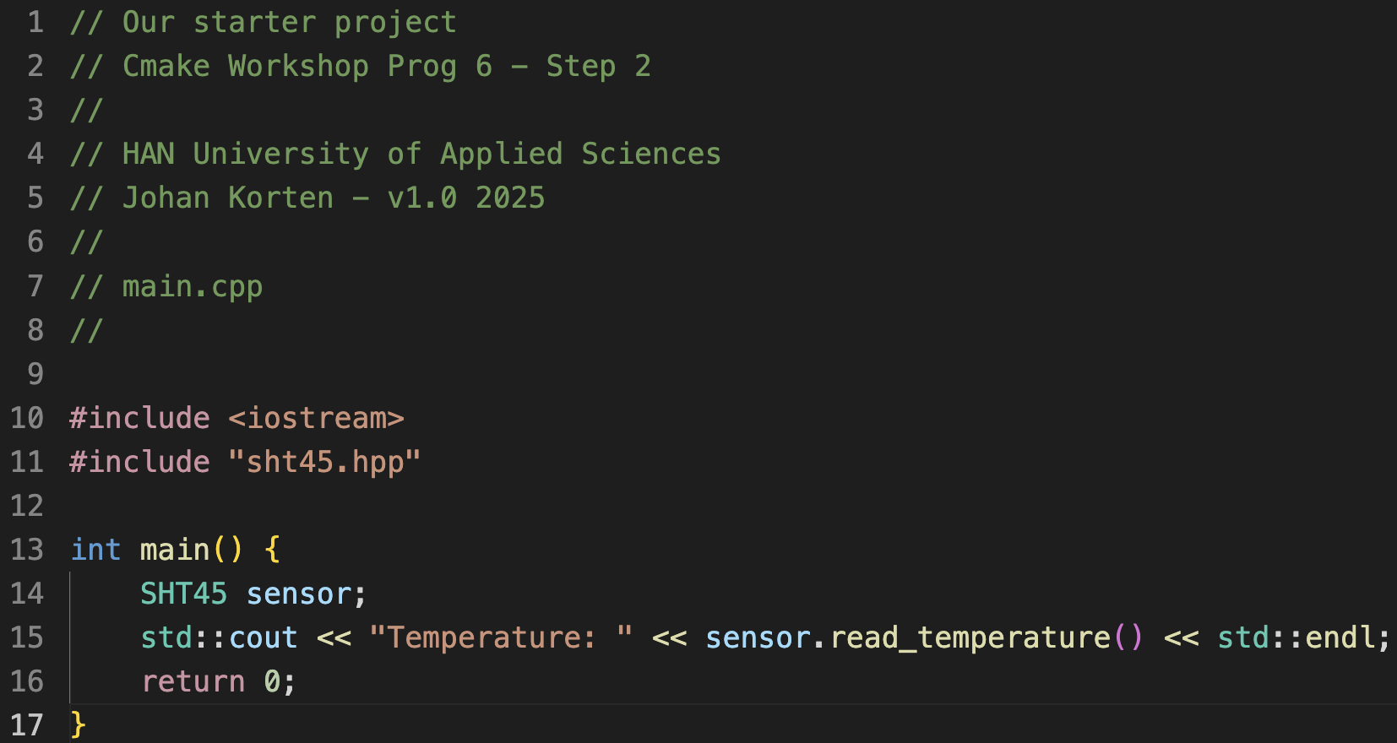
Towards a library - Stepping stone 2
Build Nightmare
Compile and test:
SimpleLibrary

Slide 8
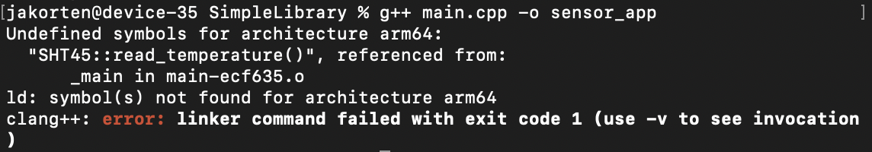
Towards a library - Stepping stone 2
Build Nightmare
Compile and test: (Whoops…)
SimpleLibrary

Slide 9
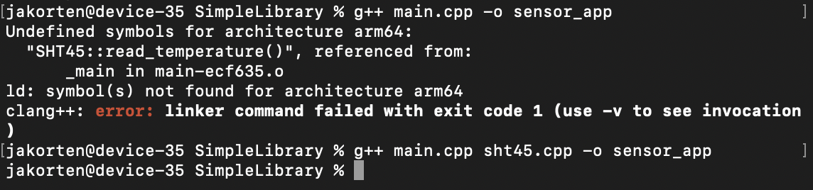
Towards a library - Stepping stone 2
Build Nightmare
Compile and test: (Pfwiew, we got away for now… )
SimpleLibrary

Slide 10
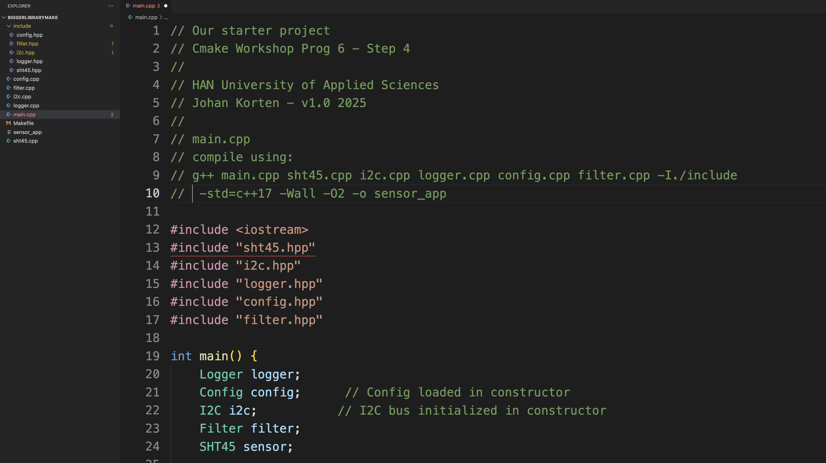
Towards a library - Stepping stone 3
Build Nightmare
BiggerLibrary

Slide 11
A bigger library - Stepping stone 4
Build Nightmare
g++ main.cpp sht45.cpp i2c.cpp logger.cpp config.cpp filter.cpp -I./include -std=c++17 -Wall -O2 -o sensor_app
BiggerLibraryMake

Slide 12
Fighting Commandline Nightmares - Stepping stone 5
Build Nightmare
g++ main.cpp sht45.cpp i2c.cpp logger.cpp config.cpp filter.cpp -I./include -std=c++17 -Wall -O2 -o sensor_app
Alternative: Makefile
# Makefile for Sensor Application
# CMake Workshop - HAN University of Applied Sciences
# Johan Korten - v1.0 2025
# Compiler and flags
CXX = g++
CXXFLAGS = -std=c++17 -Wall -Wextra -O2 -I./include
LDFLAGS =
# Target executable
TARGET = sensor_app
# Source files
SOURCES = main.cpp sht45.cpp i2c.cpp logger.cpp config.cpp filter.cpp
# Object files (replace .cpp with .o)
OBJECTS = main.o sht45.o i2c.o logger.o config.o filter.o
# Header files (for dependency tracking)
HEADERS = include/sht45.hpp include/i2c.hpp include/logger.hpp include/config.hpp include/filter.hpp
# Default target
all: $(TARGET)
# Link object files to create executable
$(TARGET): $(OBJECTS)
$(CXX) $(OBJECTS) $(LDFLAGS) -o $(TARGET)
@echo "Build complete: $(TARGET)"
# Compile main.cpp
main.o: main.cpp $(HEADERS)
$(CXX) $(CXXFLAGS) -c main.cpp
# Compile sht45.cpp
sht45.o: sht45.cpp include/sht45.hpp
$(CXX) $(CXXFLAGS) -c sht45.cpp
# Compile i2c.cpp
i2c.o: i2c.cpp include/i2c.hpp
$(CXX) $(CXXFLAGS) -c i2c.cpp
# Compile logger.cpp
logger.o: logger.cpp include/logger.hpp
$(CXX) $(CXXFLAGS) -c logger.cpp
# Compile config.cpp
config.o: config.cpp include/config.hpp
$(CXX) $(CXXFLAGS) -c config.cpp
# Compile filter.cpp
filter.o: filter.cpp include/filter.hpp
$(CXX) $(CXXFLAGS) -c filter.cpp
# Clean build artifacts
clean:
rm -f $(OBJECTS) $(TARGET)
@echo "Clean complete"
# Rebuild everything from scratch
rebuild: clean all
# Run the application
run: $(TARGET)
./$(TARGET)
# Show help
help:
@echo "Available targets:"
@echo " all - Build the application (default)"
@echo " clean - Remove all build artifacts"
@echo " rebuild - Clean and build from scratch"
@echo " run - Build and run the application"
@echo " help - Show this help message"
.PHONY: all clean rebuild run help

Slide 13
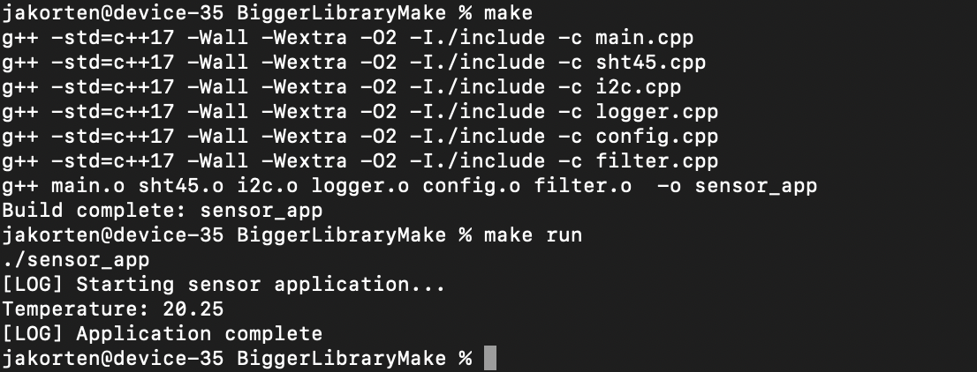
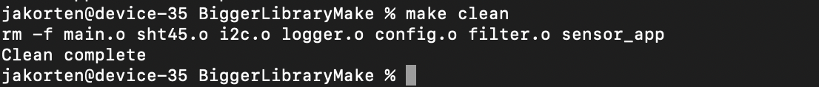
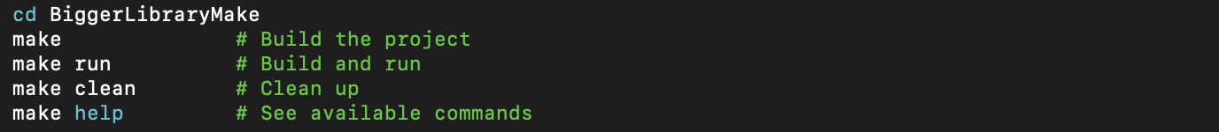
Fighting Commandline Nightmares - Stepping stone 5
Build Nightmare
BiggerLibraryMake

Slide 14
The problem of makefiles
Build Nightmare
‘Makefile hell’: 200+ lines for a simple project
IDE lock-in: Can't share code between STM32CubeIDE / VS Code / CLion / whatever.
SimpleProject

Slide 15
Fighting Commandline Nightmares - Stepping stone 5
Build Nightmare
From the cli nightmare to the make nightmare…
Pro’s:
1. Incremental compilation - Only recompiles changed files
2. Dependency tracking - Recompiles when headers change
3. Clean separation - Variables for compiler, flags, sources
4. Helper targets - clean, rebuild, run, help
5. Standard conventions - Uses CXX, CXXFLAGS, etc.
Con’s:
1. Manual listing - Every .cpp and .o file must be listed
2. Repetitive rules - 6 nearly identical compilation rules
3. Manual dependency tracking - Have to specify which .cpp depends on which .hpp
4. Platform-specific - Won't work on Windows without changes
5. Hard-coded compiler - g++ might not be available everywhere
6. Tedious maintenance - Add new file = edit 3+ places in Makefile

Slide 16
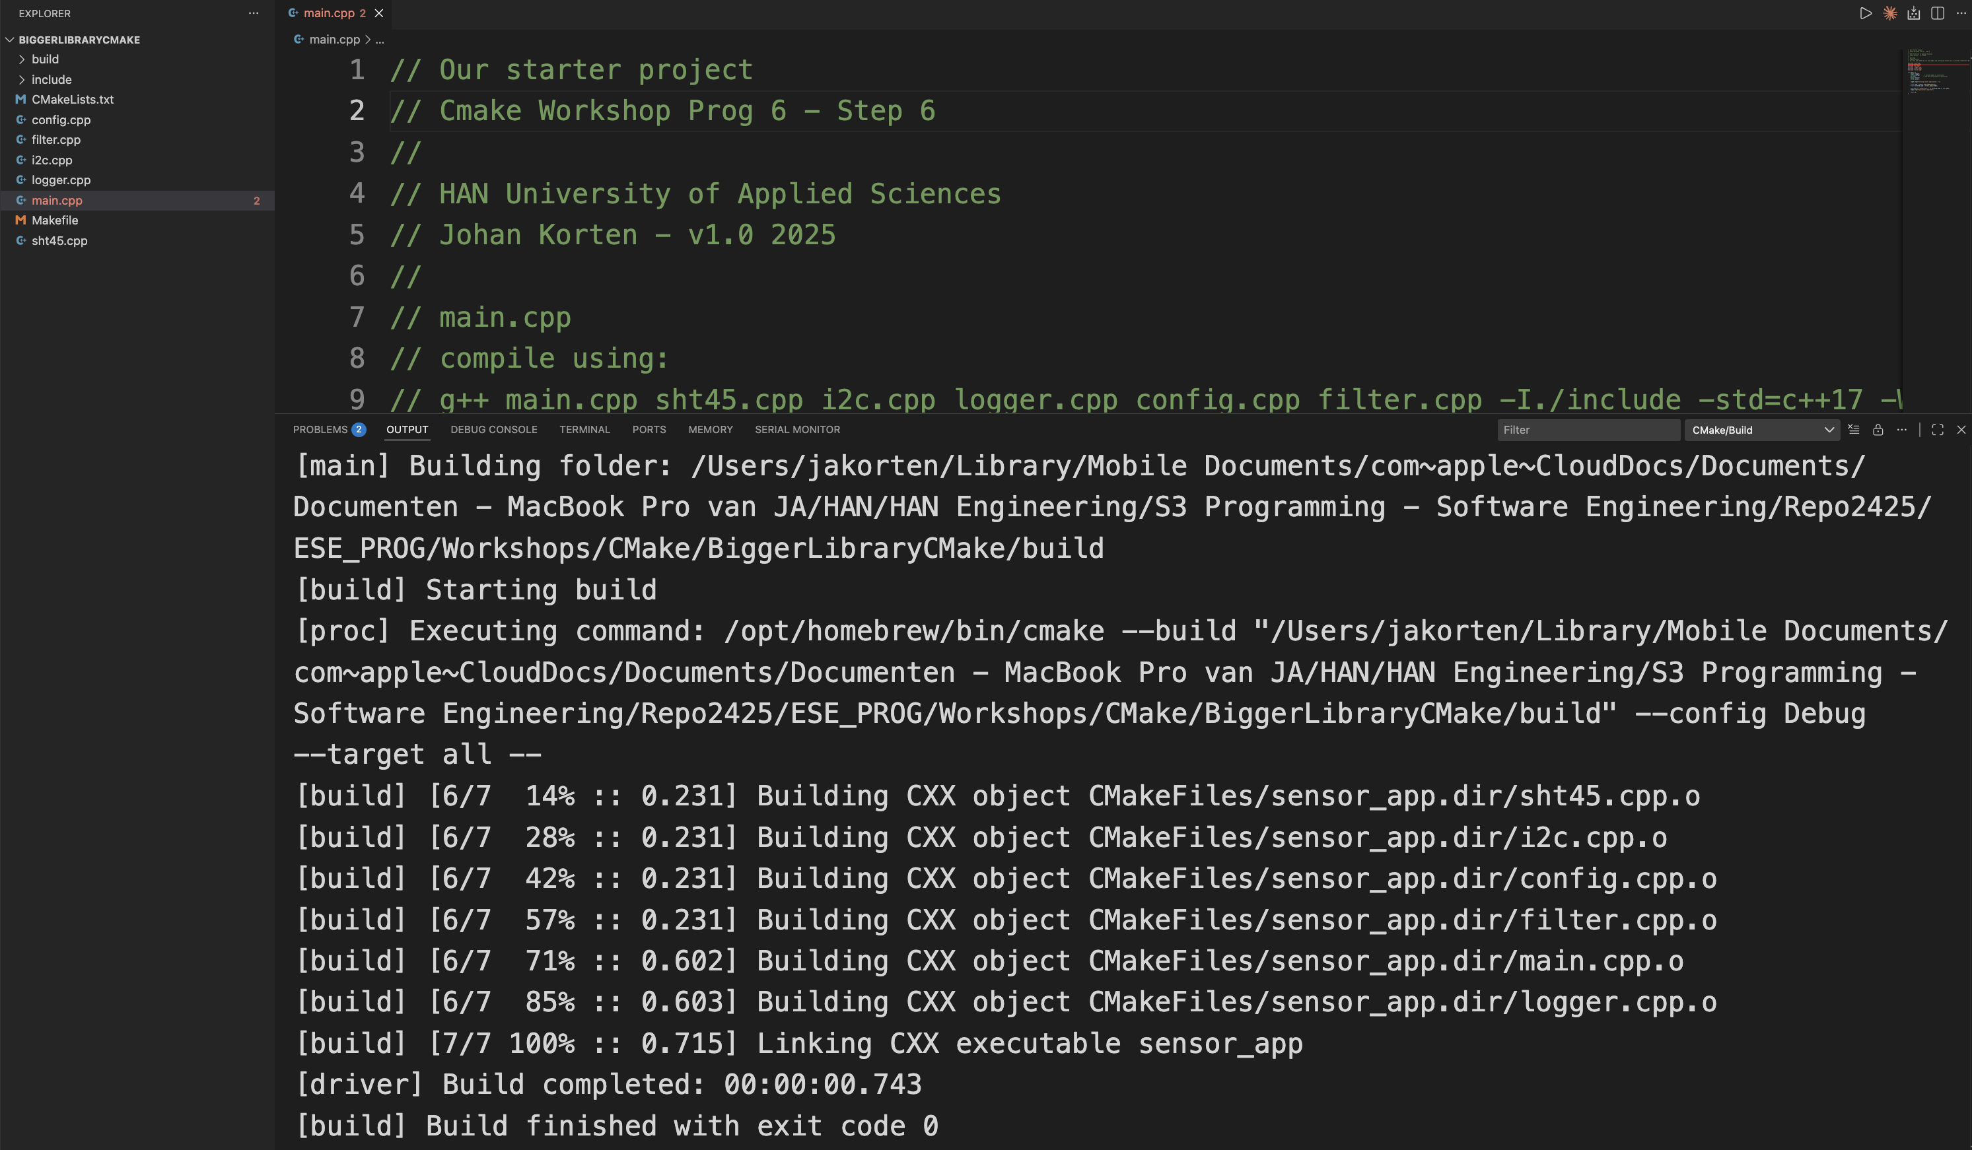
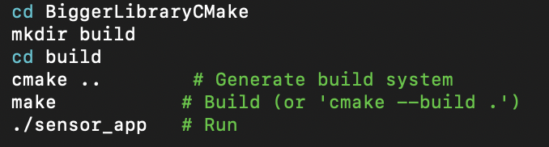
Towards a library - Stepping stone 6
Build Nightmare
BiggerLibraryCMake

Slide 17
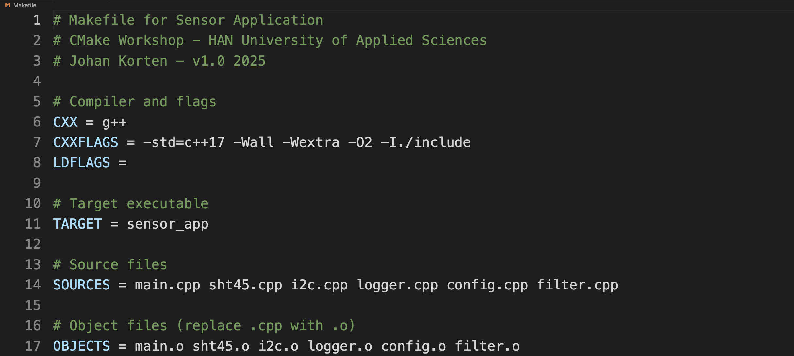
Towards a library - Stepping stone 6
Build Nightmare
Makefile 1/5 1..17
BiggerLibraryCMake

Slide 18
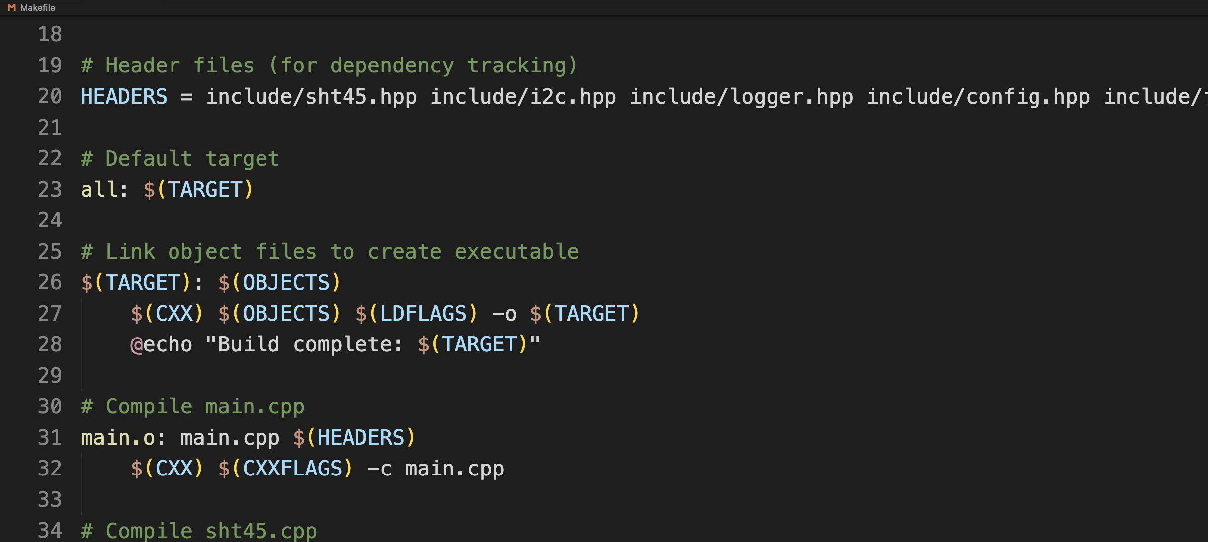
Towards a library - Stepping stone 6
Build Nightmare
Makefile 2/5 18..33
BiggerLibraryCMake

Slide 19
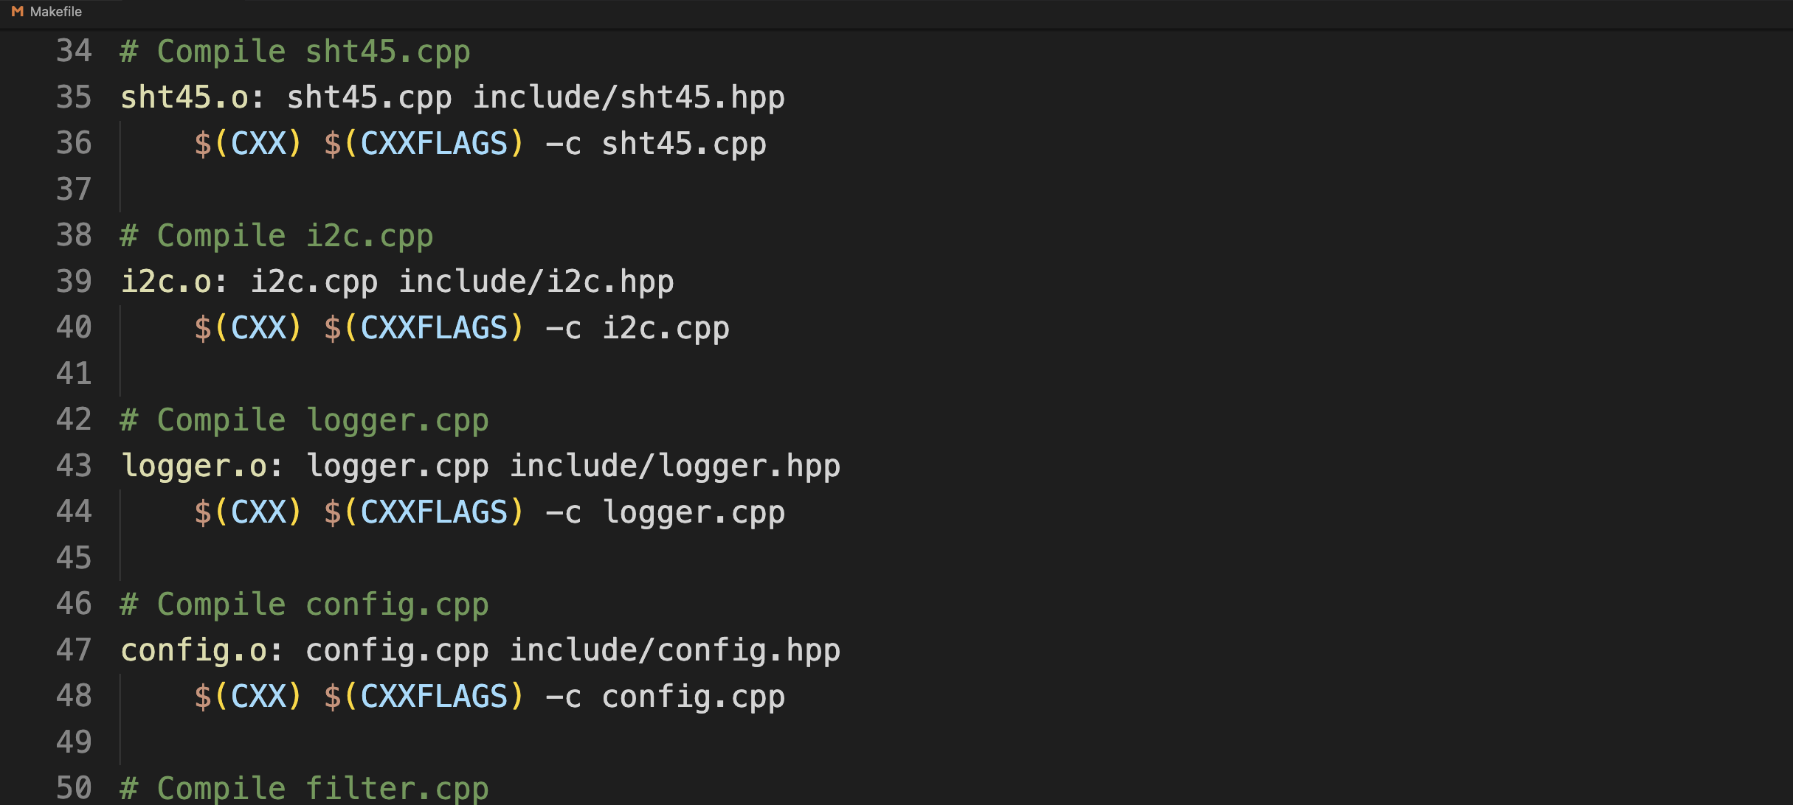
Towards a library - Stepping stone 6
Build Nightmare
Makefile 3/5 34..49
BiggerLibraryCMake

Slide 20
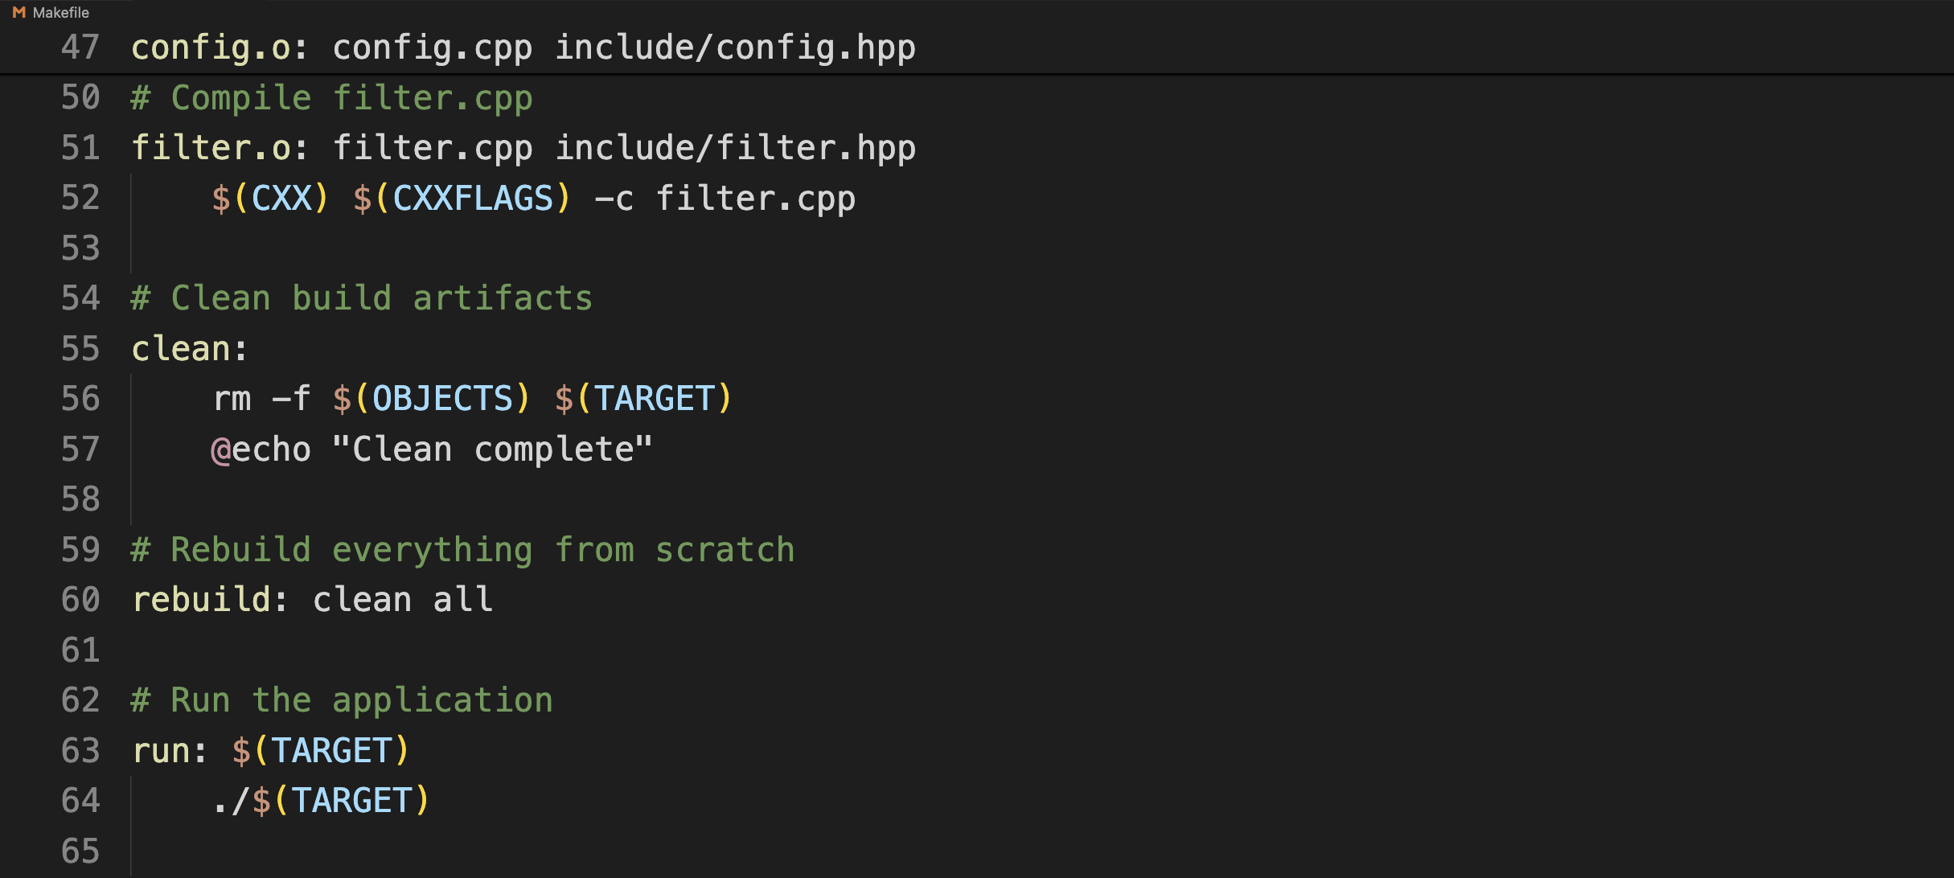
Towards a library - Stepping stone 6
Build Nightmare
Makefile 4/5 47..64
BiggerLibraryCMake

Slide 21
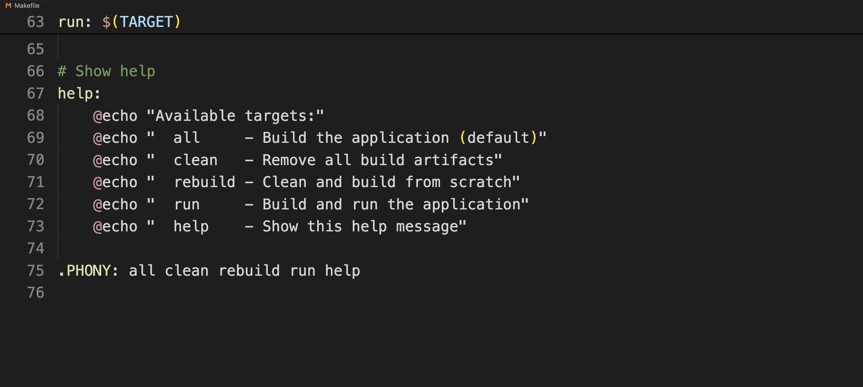
Towards a library - Stepping stone 6
Build Nightmare
Makefile 5/5 47..64
BiggerLibraryCMake

Slide 22
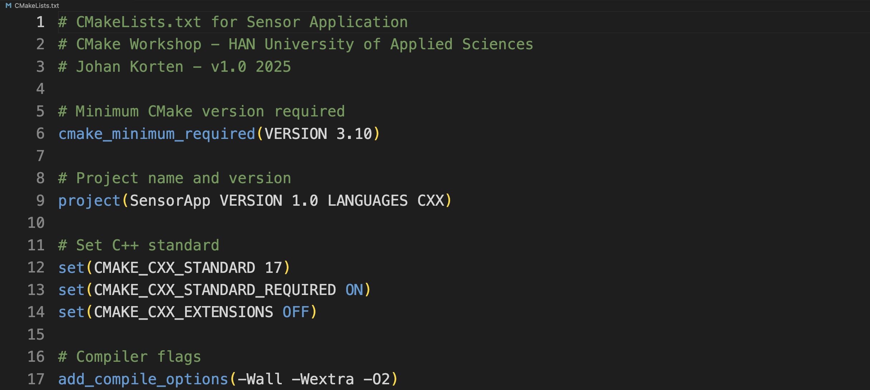
Towards a library - Stepping stone 6
Build Nightmare
CMakeLists.txt
1/2 1..17
BiggerLibraryCMake

Slide 23
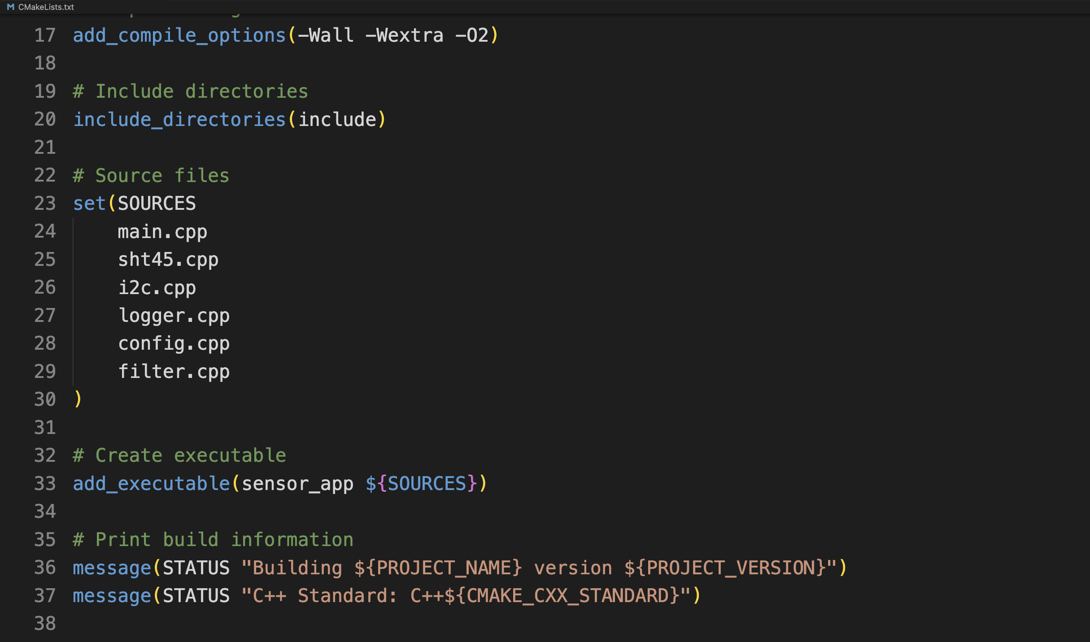
Towards a library - Stepping stone 6
Build Nightmare
CMakeLists.txt
2/2 17..37
BiggerLibraryCMake

Slide 24
Makefile versus CMakeLists.txt
Build Nightmare
1. No manual .o file listing - CMake figures it out
2. No repetitive rules - One add_executable() does it all
3. Automatic dependency tracking - CMake scans headers
4. Cross-platform - Same file works on Windows/Linux/Mac
5. Modern build system - Generates Makefiles, Visual Studio projects, Ninja, etc.

Slide 25
Makefile versus CMakeLists.txt
Build Nightmare
# Just list the sources
set(SOURCES
main.cpp
sht45.cpp
i2c.cpp
logger.cpp
config.cpp
filter.cpp
)
# CMake figures out the rest!
add_executable(sensor_app ${SOURCES})

Slide 26
Workshop Topics for Today
Up-to-date CMake
- Overcoming the Build Nightmare
- Cmake ins- and outs
- Cmake for Embedded targets
- Alternatives to make

Slide 27
Towards a library - Stepping stone 6
Up-to-date CMake
BiggerLibraryCMakeV2:
Stage 1 - What we currently have
Stage 2 - Updated CMake
Stage 3 - Separate libraries for reusability
Stage 4 - FetchContent for external libraries
Stage 5 - How real projects configure CMake
Stage 6 - CMake for Embedded Systems targets
BiggerLibraryCMakeV2

Slide 28
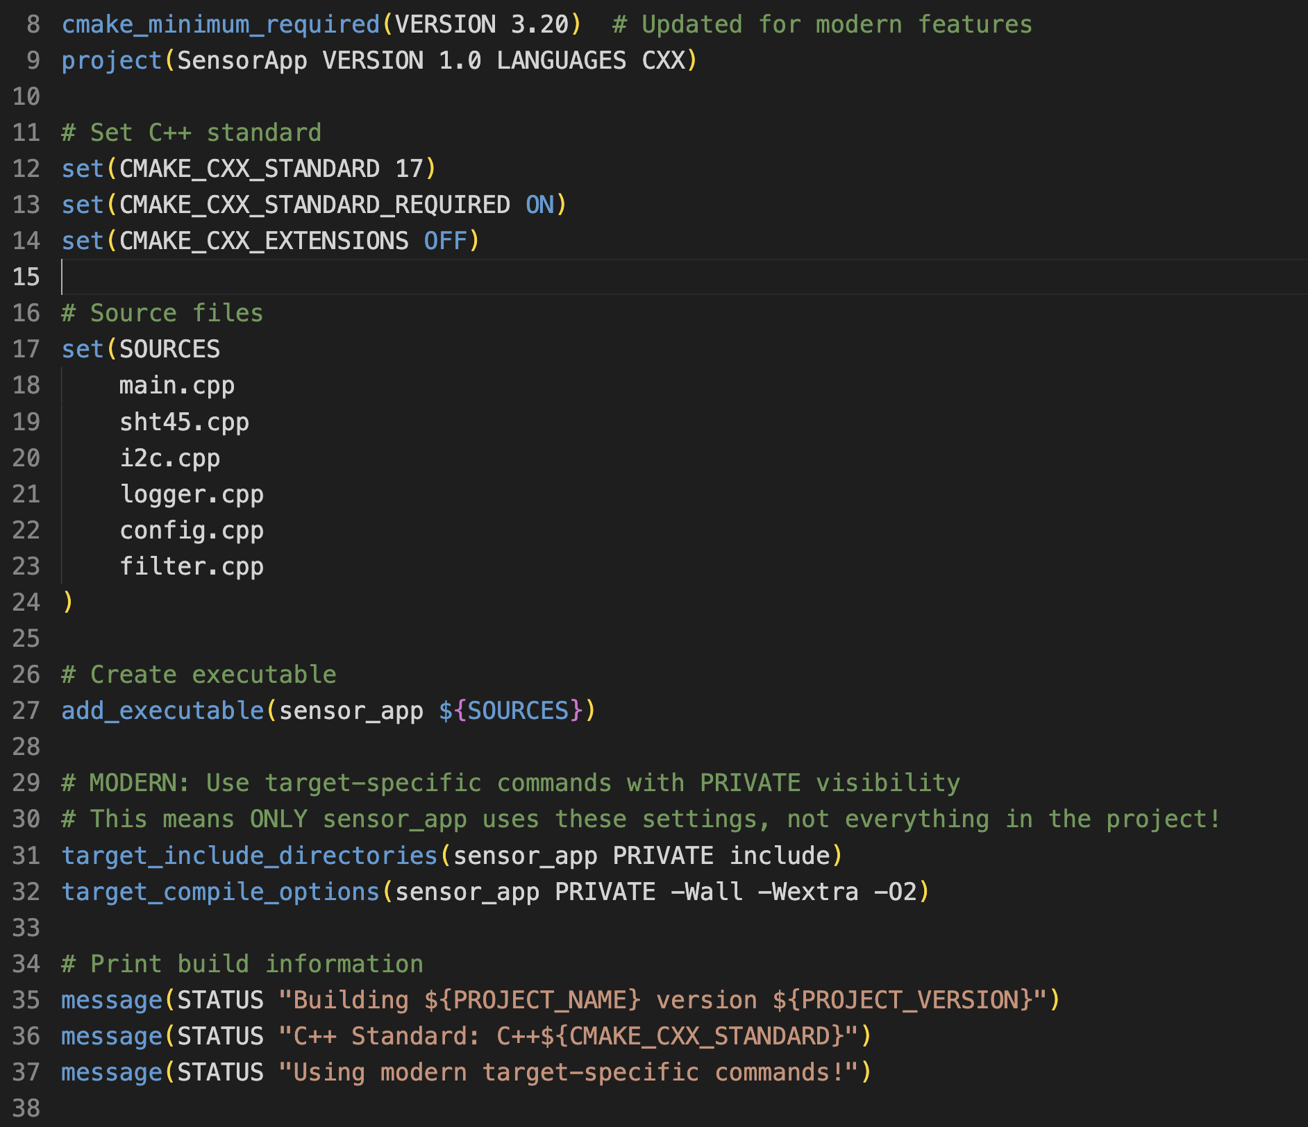
CMake V2 stage2
Up-to-date CMake
BiggerLibraryCMakeV2:
3.20+ to use ‘modern’ features.
Tip: always use “PRIVATE” unless you need
INTERFACE or PUBLIC
BiggerLibraryCMakeV2

Slide 29
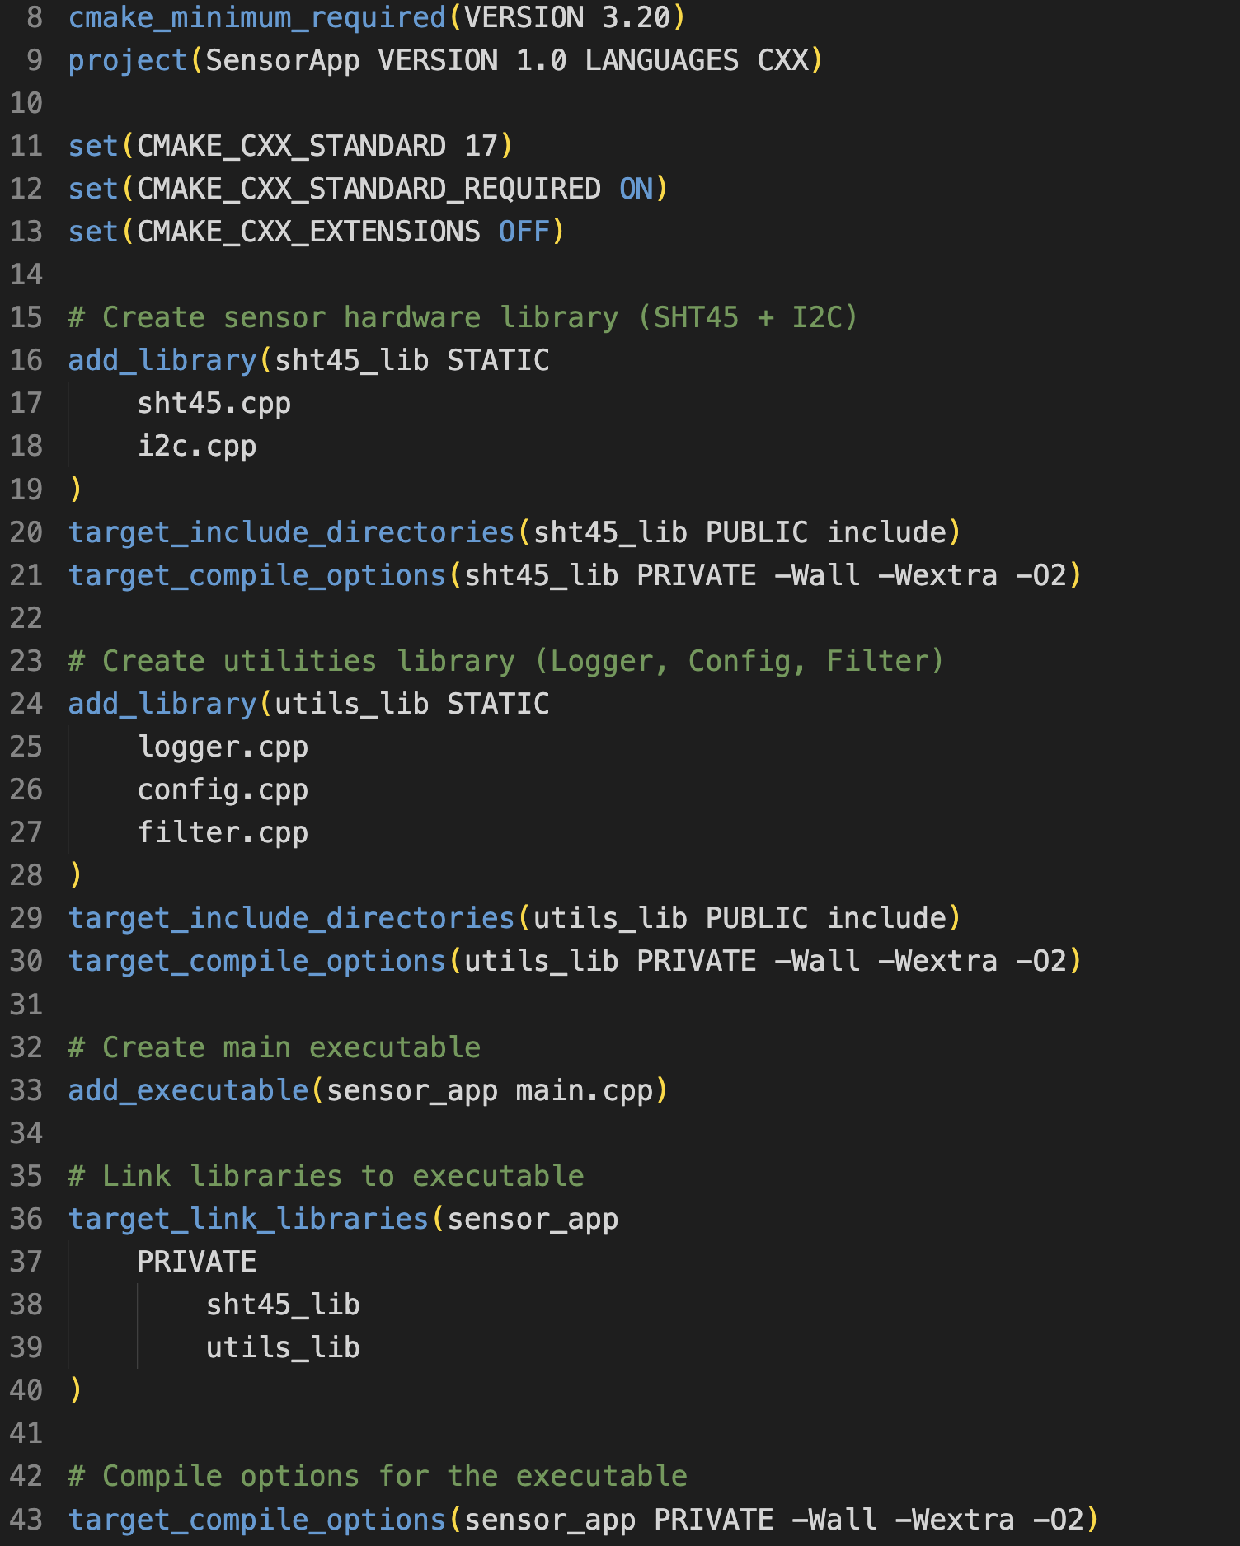
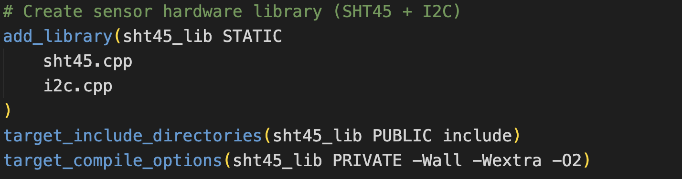
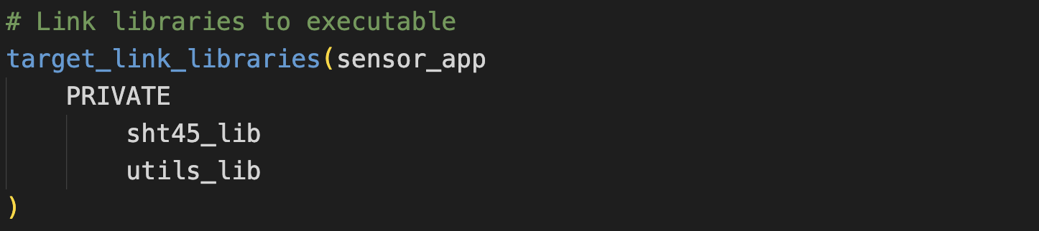
CMake V2 stage3
Up-to-date CMake
BiggerLibraryCMakeV2:
Using Libraries:
BiggerLibraryCMakeV2

Slide 30
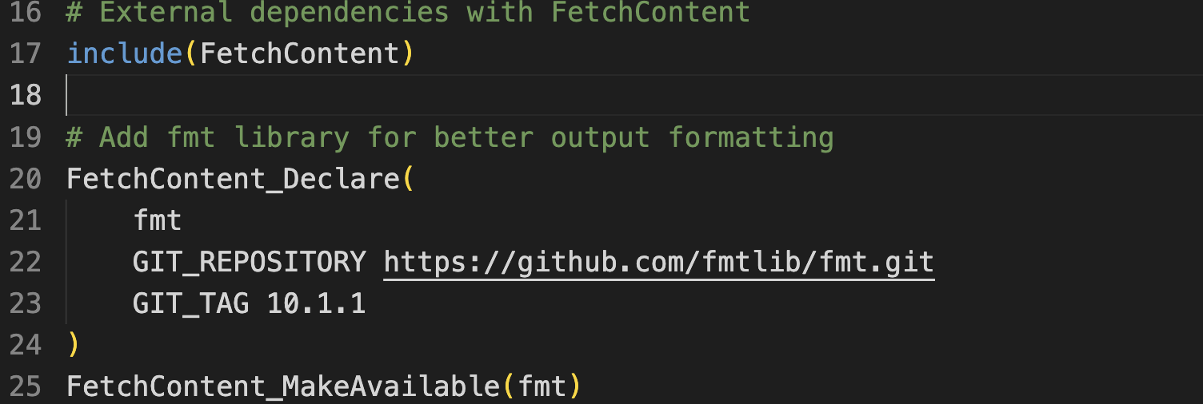
CMake V2 stage4
Up-to-date CMake
BiggerLibraryCMakeV2:
External Dependencies (Automatic Dependency Management)
BiggerLibraryCMakeV2

Slide 31
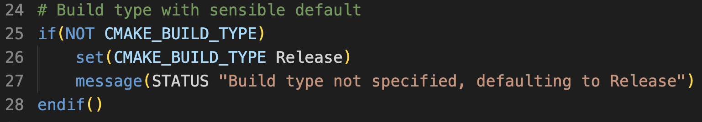
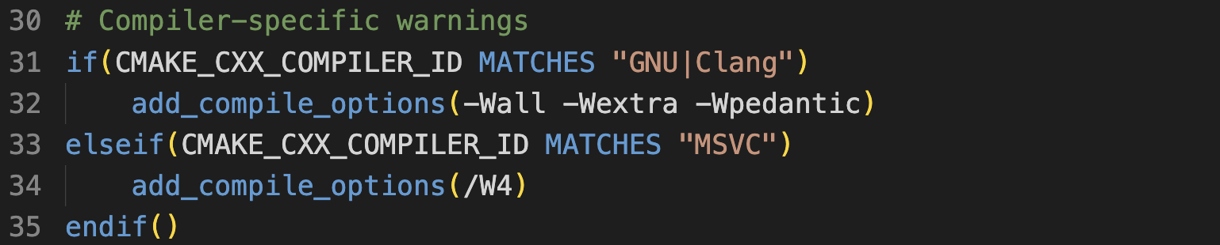
CMake V2 stage5
Up-to-date CMake
BiggerLibraryCMakeV2:
More advanced options including conditions
BiggerLibraryCMakeV2

Slide 32
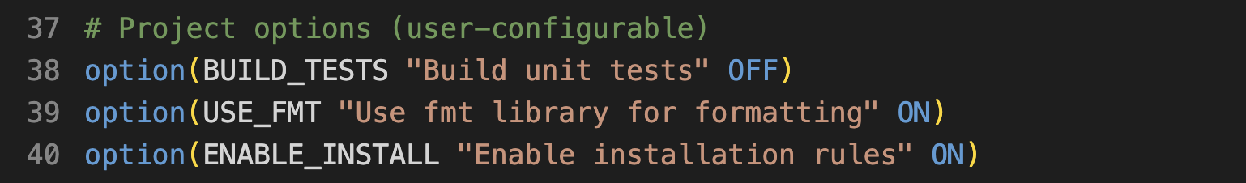
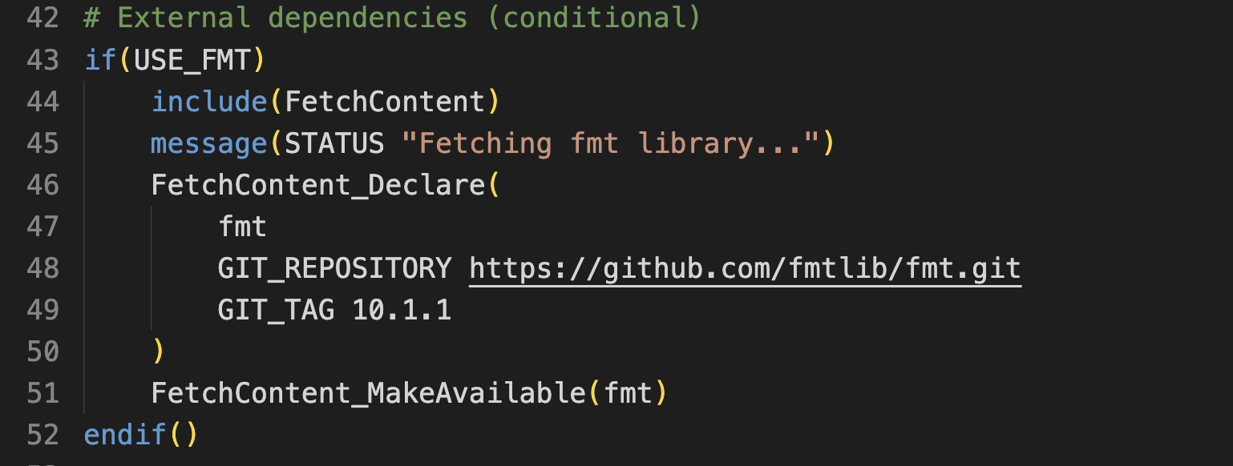
CMake V2 stage5
Up-to-date CMake
BiggerLibraryCMakeV2:
More advanced options including conditions
BiggerLibraryCMakeV2

Slide 33
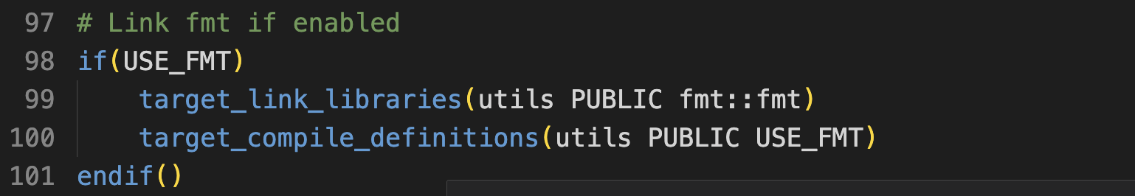
CMake V2 stage5
Up-to-date CMake
BiggerLibraryCMakeV2:
More advanced options including conditions
BiggerLibraryCMakeV2

Slide 34
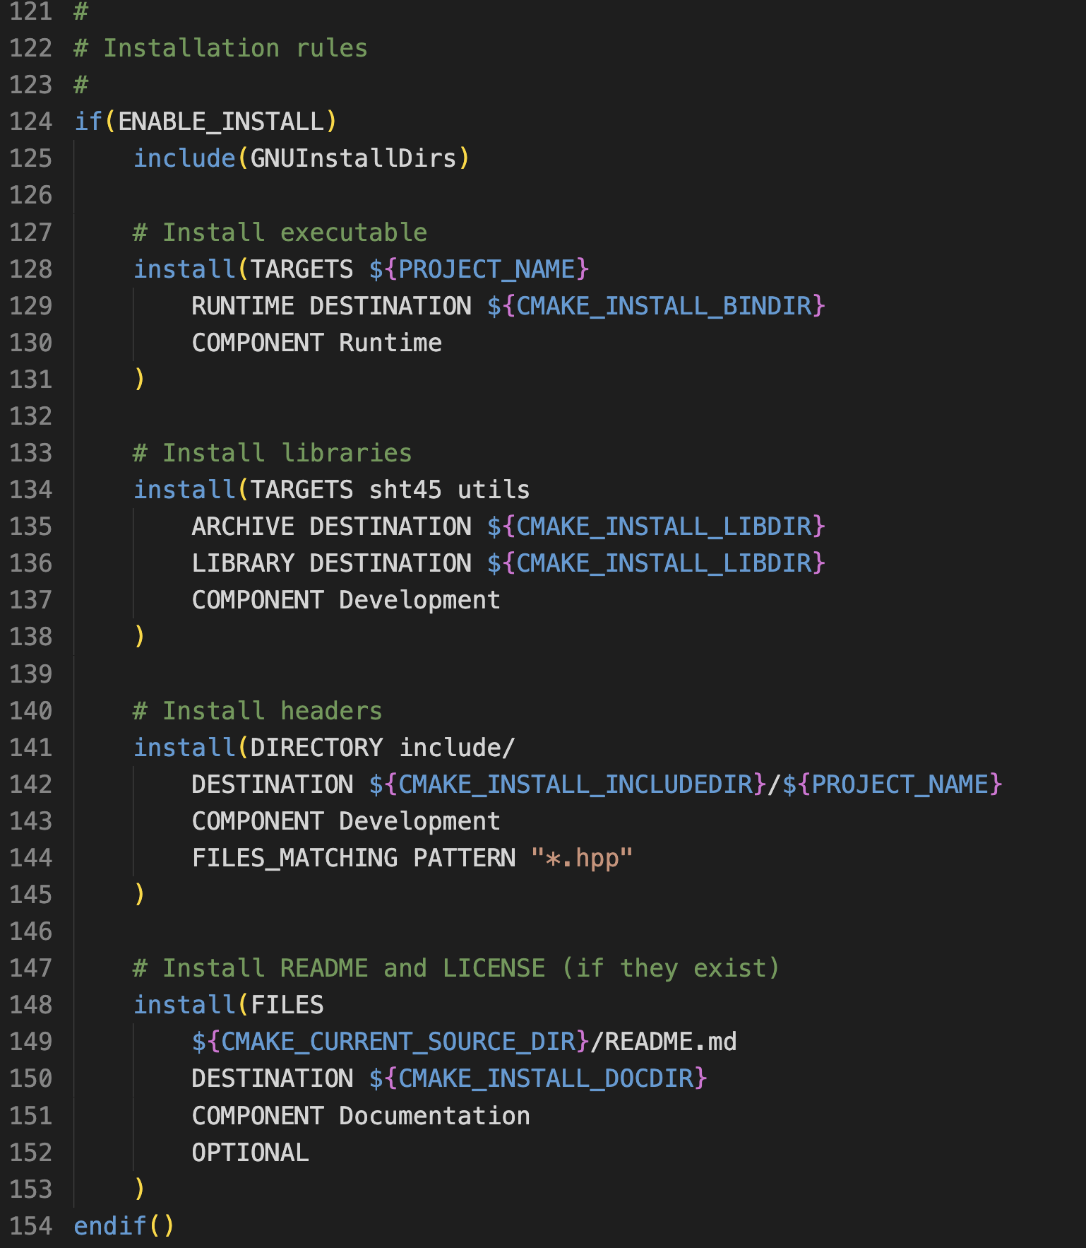
CMake V2 stage5
Up-to-date CMake
BiggerLibraryCMakeV2:
Useful for e.g. CI/CD:
BiggerLibraryCMakeV2

Slide 35
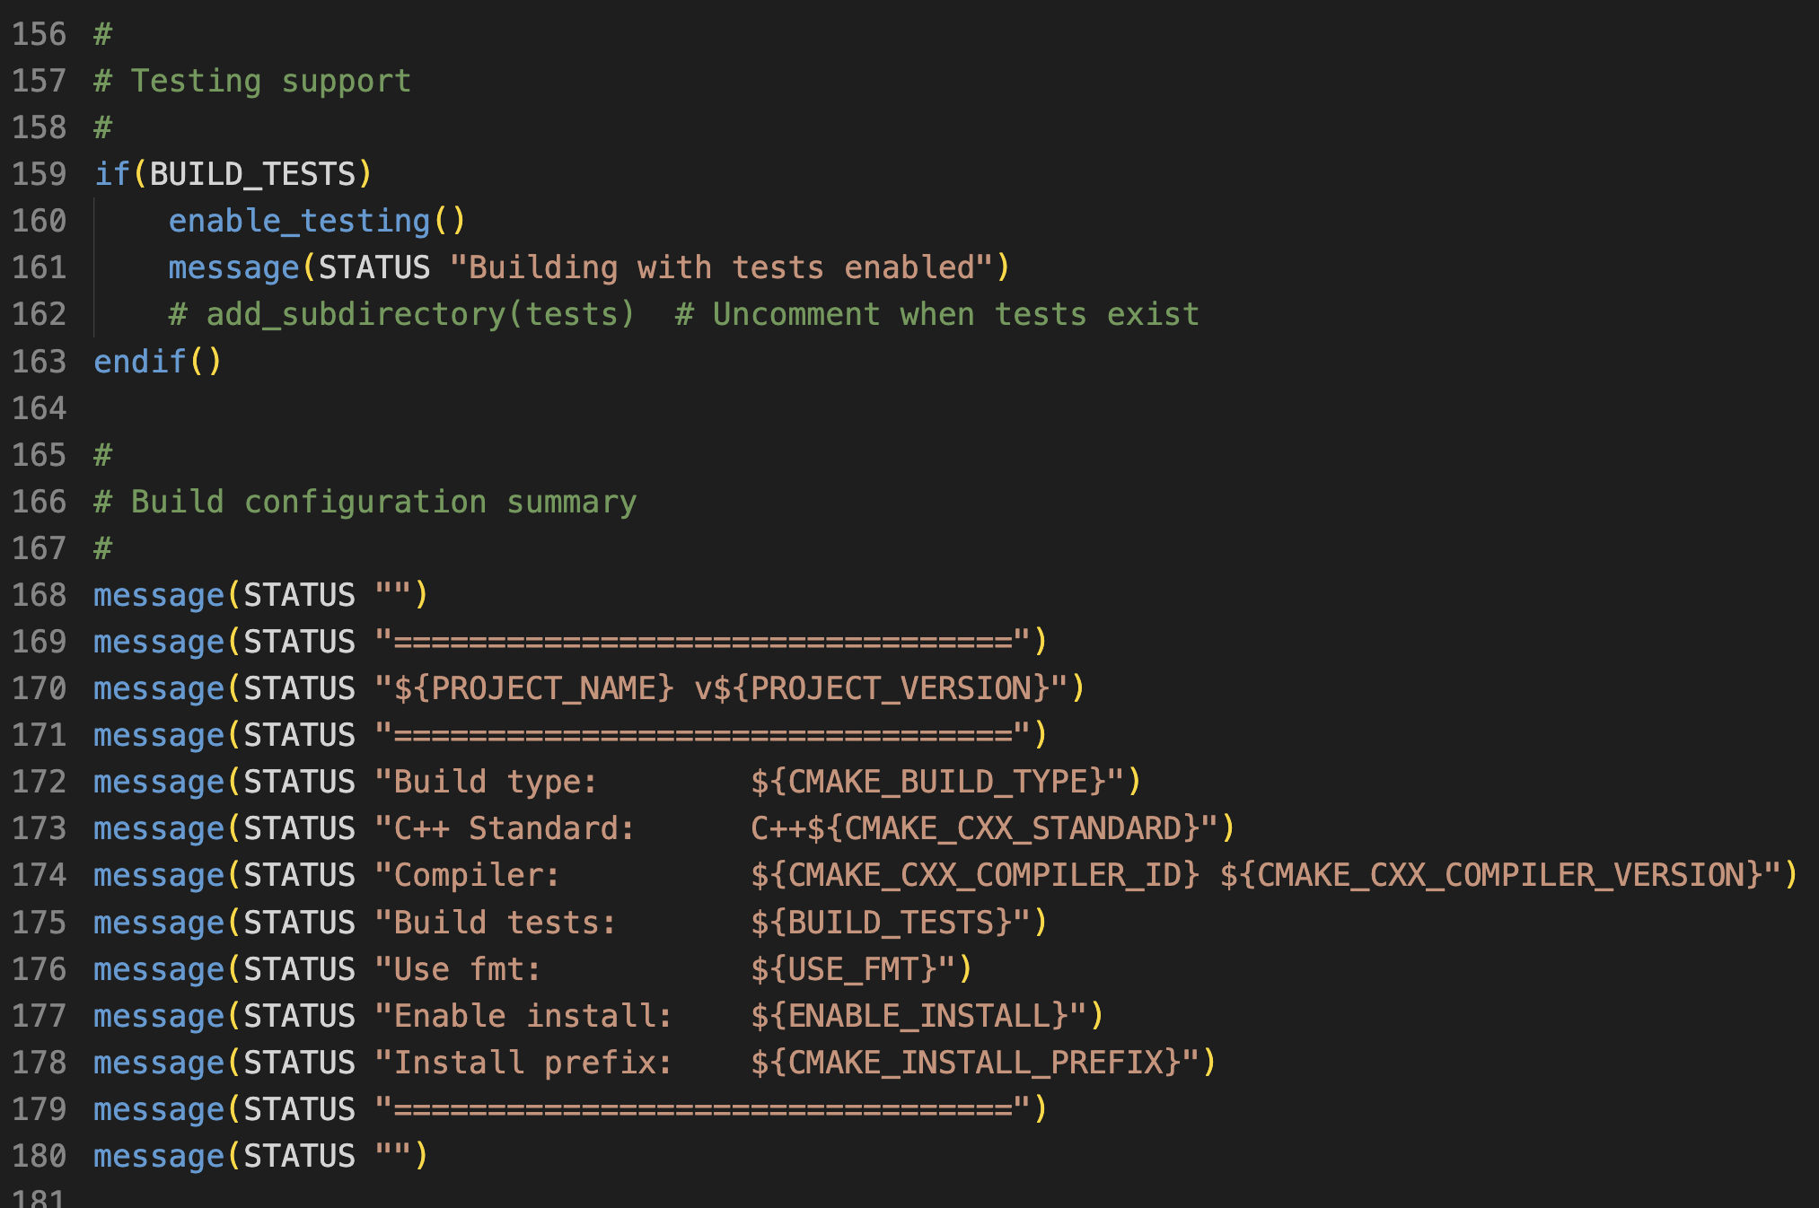
CMake V2 stage5
Up-to-date CMake
BiggerLibraryCMakeV2:
Build config summary:
BiggerLibraryCMakeV2

Slide 36
CMake V2 stage5
Up-to-date CMake
BiggerLibraryCMakeV2:
More on this next week:
BiggerLibraryCMakeV2

Slide 37
Workshop Topics for Today
- Overcoming the Build Nightmare
- Cmake ins- and outs
- Cmake for Embedded targets
- Alternatives to Make

Slide 38
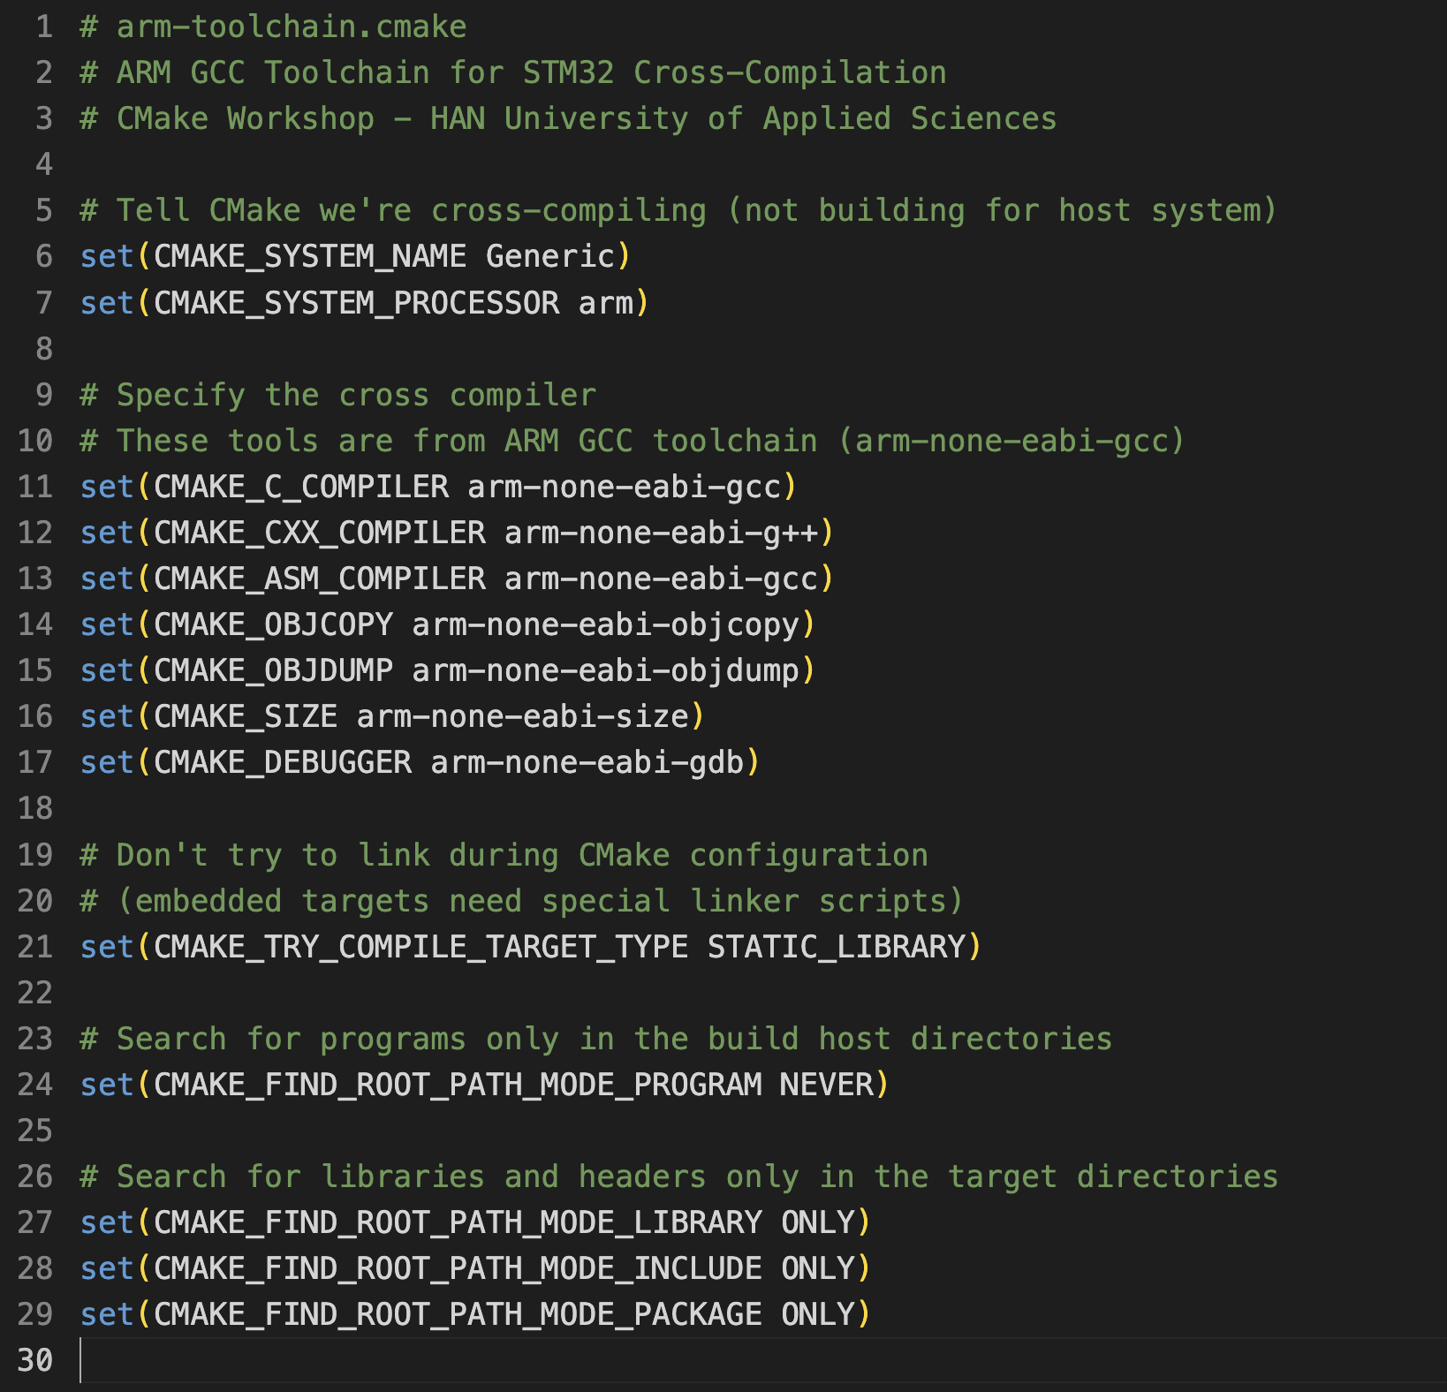
CMake V2 stage6
Embedded CMake
BiggerLibraryCMakeV2:
arm-toolchain.cmake
BiggerLibraryCMakeV2

Slide 39
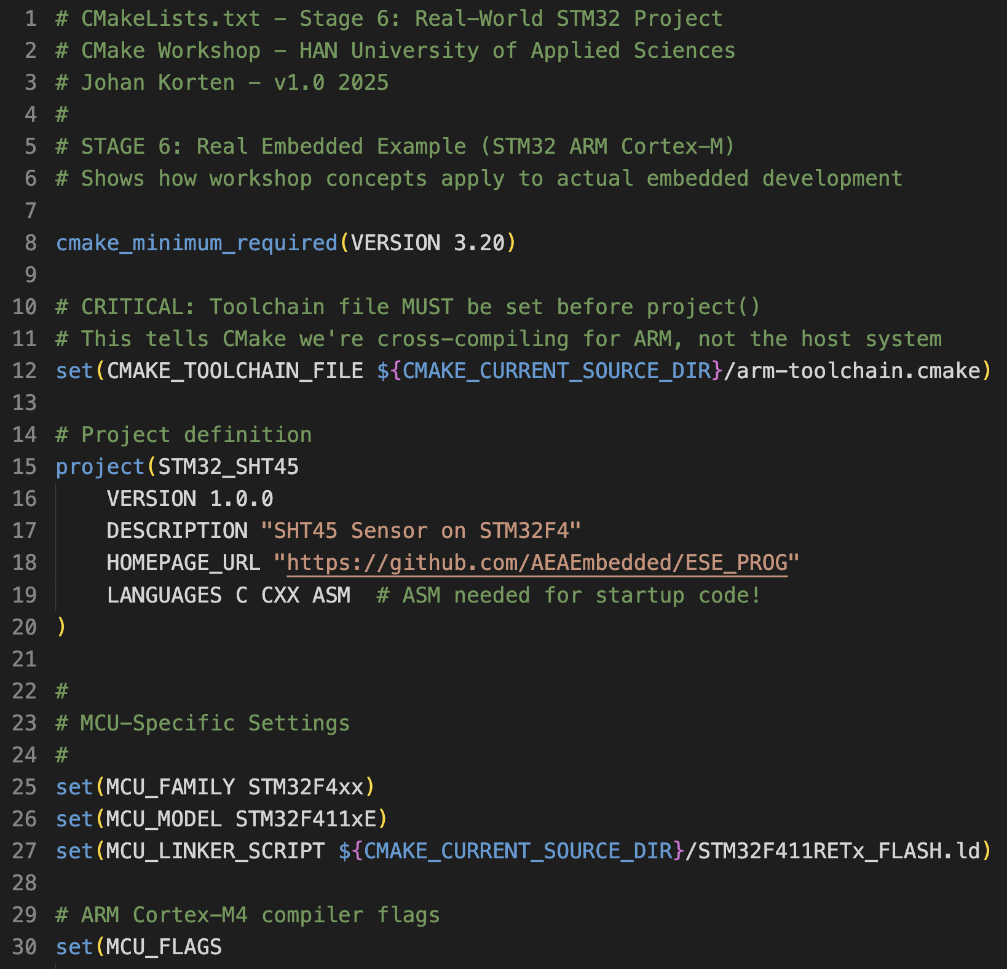
CMake V2 stage6
Embedded CMake
BiggerLibraryCMakeV2:
CMakeLists.txt for an
embedded target:
BiggerLibraryCMakeV2

Slide 40
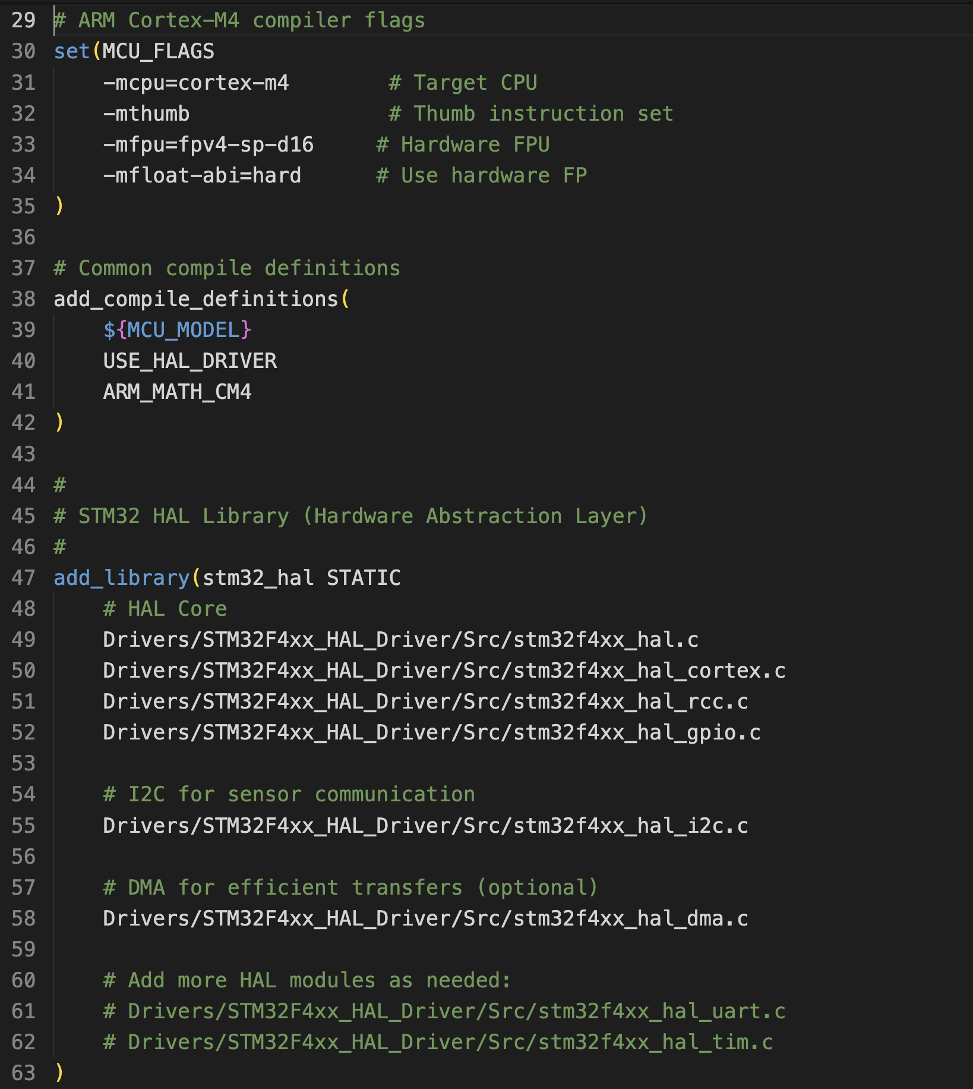
CMake V2 stage6
Embedded CMake
BiggerLibraryCMakeV2:
CMakeLists.txt for an
embedded target:
BiggerLibraryCMakeV2

Slide 41
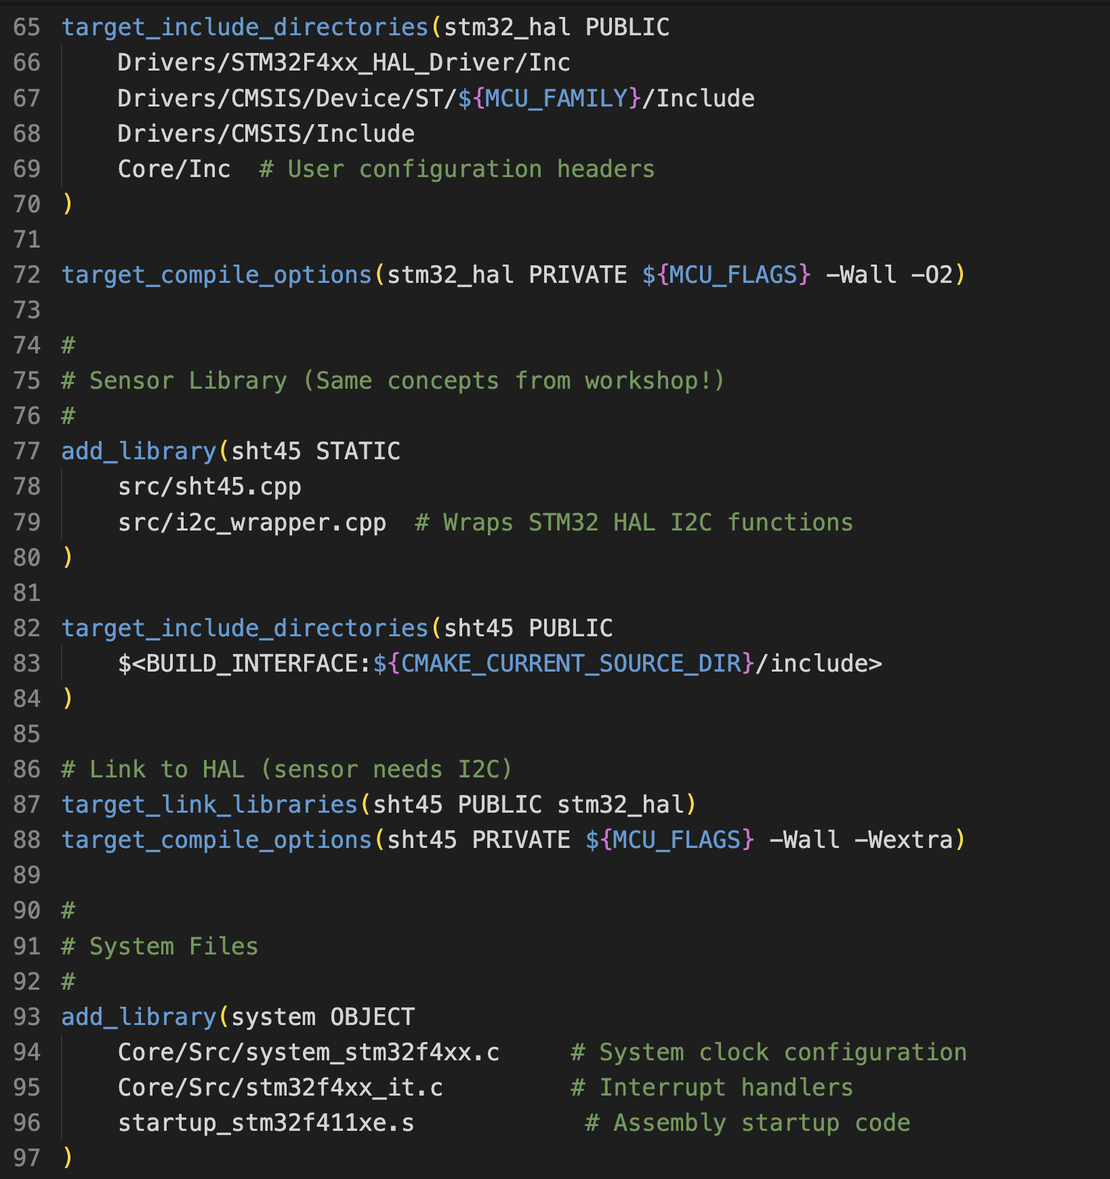
CMake V2 stage6
Embedded CMake
BiggerLibraryCMakeV2:
CMakeLists.txt for an
embedded target:
BiggerLibraryCMakeV2

Slide 42
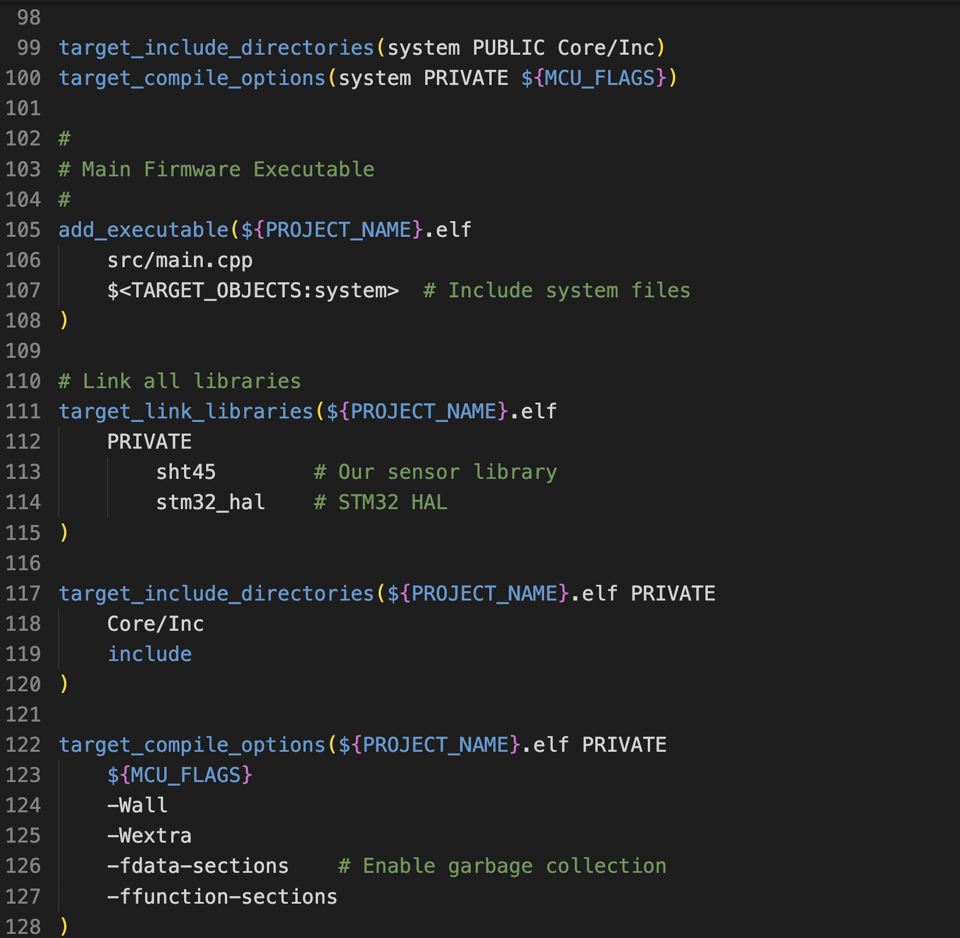
CMake V2 stage6
Embedded CMake
BiggerLibraryCMakeV2:
CMakeLists.txt for an
embedded target:
BiggerLibraryCMakeV2

Slide 43
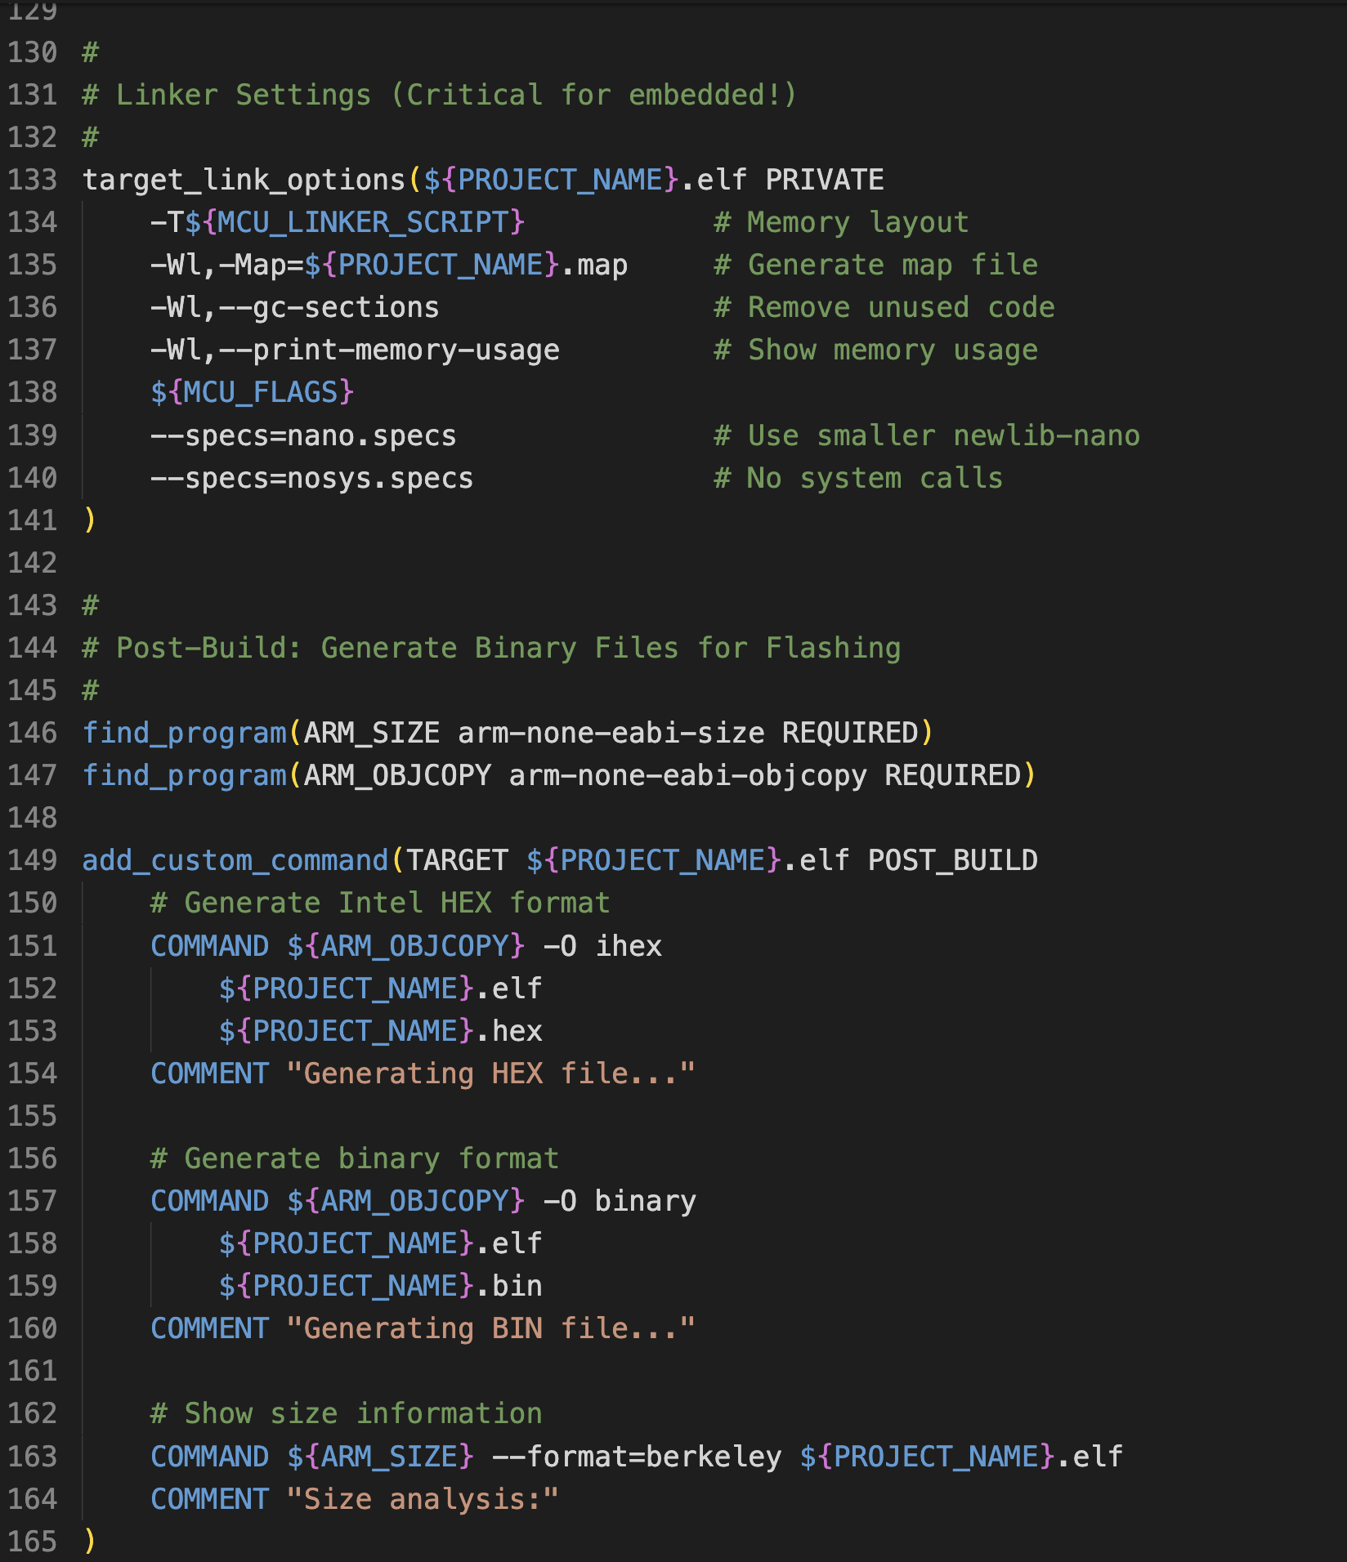
CMake V2 stage6
Embedded CMake
BiggerLibraryCMakeV2:
CMakeLists.txt for an
embedded target:
BiggerLibraryCMakeV2

Slide 44
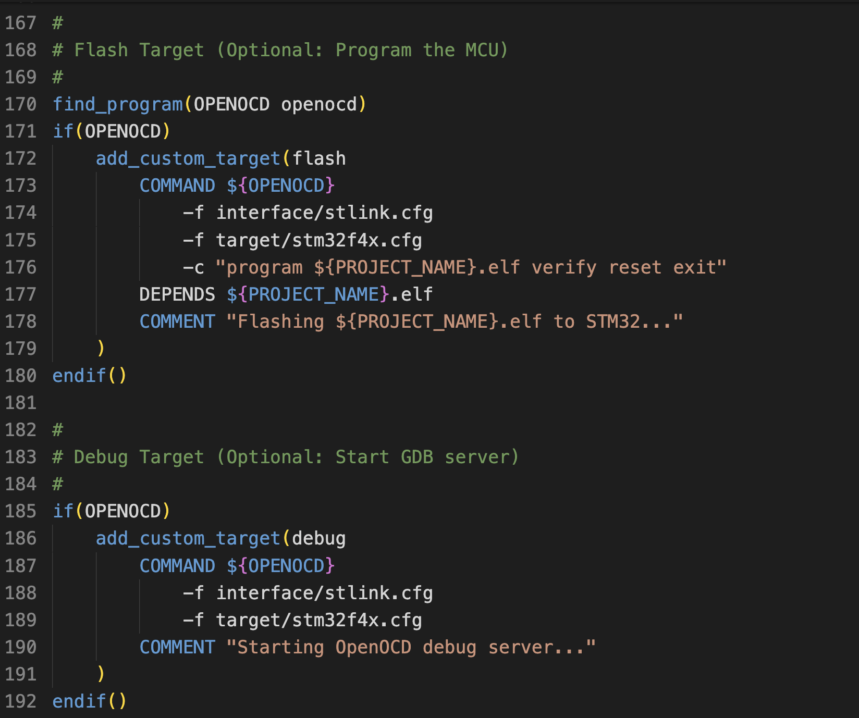
CMake V2 stage6
Embedded CMake
BiggerLibraryCMakeV2:
CMakeLists.txt for an
embedded target:
BiggerLibraryCMakeV2

Slide 45
What if CMake gets confused
- cmake --build build --target clean
CMakeCache.txt / CMakeFiles/ any cached options you set before are kept.
If you then still run into problems: Pristine build
- rm -rf build
- cmake -S . -B build
- cmake --build build

Slide 46
Alternative to Make: Ninja
Ninja is a build system (like Make) but designed to be fast.
CMake can generate Ninja build files instead of Makefiles.

Slide 47
Alternative to Make: Ninja
Ninja is a build system (like Make) but designed to be fast.
CMake can generate Ninja build files instead of Makefiles.
cmake -B build_make time cmake --build build_make
cmake -B build_ninja -G Ninja time
cmake --build build_ninja
Make: 2.3 seconds
Ninja: 0.8 seconds

Slide 48
Alternative to Make: Ninja
Why Ninja is Faster:
No shell overhead - Make spawns shells, Ninja doesn't
Parallel by default - Ninja automatically uses all cores
Minimal features - Ninja only builds, Make has a lot of often not used features
Better dependency tracking - Rebuilds only what's needed
Embedded projects with 100+ files compile in seconds, not minutes
Faster iteration = more learning
Industry uses Ninja (Google Chrome, Android, LLVM)

Slide 49
Alternative to Make: Ninja and others
For your embedded systems:
- Ninja - Fast, simple, used by modern CMake
- Meson - Great cross-compilation support
- Bazel - If working with larger embedded projects
- SCons/Waf - Common in embedded open source
The trend is toward:
- Faster incremental builds (Ninja, tup)
- Better dependency tracking (Bazel, Buck2)
- Cross-platform support (Meson, CMake+generators)
- Reproducible builds (Bazel, Nix-based systems)

Slide 50
That’s all…
Any questions?

